Slide 1

Git & GitHub
Master Version Control for Collaborative Development
Created by: Hafiz Haris Mehmood

Slide 2

Why Version Control Matters
Without version control, teams face difficuilities: lost code versions, overwritten work, and confusing file names like "final_project_v3_last_final.py". Version control solves these problems by tracking every change, enabling safe collaboration, and preserving your entire project history.
Prevent Data Loss
Enable Collaboration
Recover any previous version instantly
Multiple people work without conflicts
Track Changes
Know who changed what and when

Slide 3
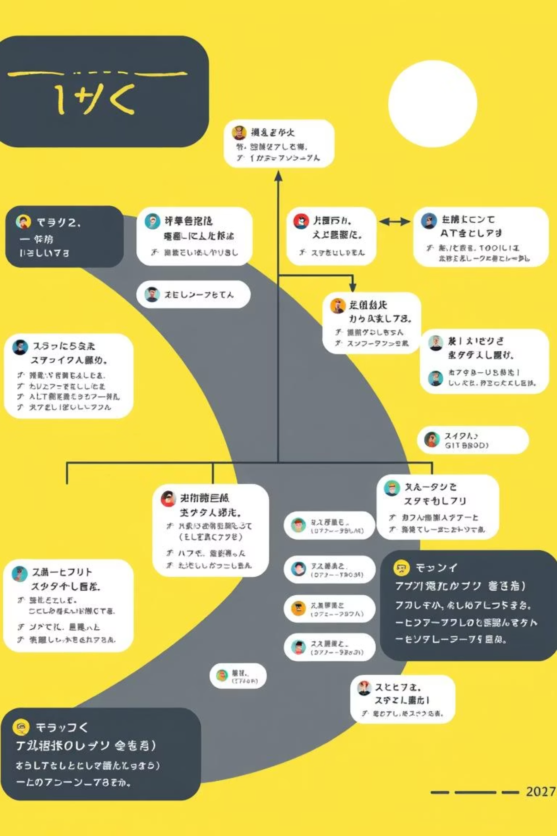
Understanding Git Fundamentals
Git is a Distributed Version Control System (DVCS). It works entirely on your local machine, tracking every code change, enabling safe experimentation through branches, and facilitating seamless collaboration without requiring internet connectivity.
Track Changes
Record every modification to your files with timestamps and messages
Restore Versions
Return to any previous state of your project instantly
Branch Safely
Develop new features in isolation without affecting main code
Merge Effectively
Combine different versions without losing anyone's work

Slide 4

Git vs GitHub: Know the Difference
Git and GitHub are complementary but distinct tools. Git is a local version control system installed on your computer, while GitHub is a cloud-based platform for hosting, sharing, and collaborating on Git repositories online.
Git
GitHub
Local version control
Cloud repository hosting
Command-line tool
Web-based platform
Works offline
Requires internet
No internet required
Enables collaboration

Slide 5

How Git Works: The Three-Stage Workflow
Git operates through three distinct stages. First, you modify files in your Working Directory. Then, you stage specific changes in the Staging Area. Finally, you commit those changes to your Local Repository, creating a permanent record in your project's history.
01
02
Working Directory
Staging Area
Your project folder where you make and edit files
Prepare specific changes before committing them
03
Local Repository
Permanently saved committed changes

Slide 6

Essential Git Commands You Need
These fundamental commands form the backbone of daily Git work. Master them to efficiently manage your project versions, track changes, and collaborate with teammates.
Action
Command
Initialize repository
git init
Check status
git status
Stage files
git add filename
Stage all changes
git add .
Commit changes
git commit -m "message"
View history
git log
Restoring Previous Version
git checkout [commit code]
Always run git status before committing — it prevents confusion and ensures you're tracking the right files.

Slide 7

First-Time GitHub Setup: Connect Your Profile
Before you can effectively use Git with GitHub, you need to configure your local Git installation with your GitHub credentials. This one-time setup ensures your commits are properly attributed to your GitHub account.
01
02
Configure Your Username
Configure Your Email
Set the username that will be associated with your commits. This should match the name on your GitHub profile for proper attribution.
Set the email address for your commits. Ensure this email is linked to your GitHub account.
git config --global user.email "your.email@example.com"
git config --global user.name "Your Name"
Important Note: This global configuration is a one-time process for your machine. It ensures that every commit you make is correctly linked to your identity, allowing for accurate commit history and collaboration tracking on GitHub.

Slide 8

Connecting to GitHub: Your Cloud Backup
Push your local Git repository to GitHub to store it online, enable backups, and facilitate team collaboration. Link your local repository to GitHub, then synchronise your code between your computer and the cloud platform through simple push and pull commands.
1
Create GitHub Repository
Set up a new repository on GitHub's website
2
Link Local Repository
git remote add origin [GitHub-URL]
3
Push Your Code
git push -u origin main
4
Pull Updates Later
git pull origin main

Slide 9
Best Practices for Professional Git Usage
Follow these essential practices to maintain clean, understandable, and conflict-free projects — especially crucial when working in teams. Consistent habits prevent chaos, improve collaboration, and build professional reputation within development communities.
Commit Often
Clear Commit Messages
Save progress frequently with logical, bite-sized commits
Write descriptive messages like "Added data cleaning script" not "fixed stuff"
Use Branches Always
Pull Before Pushing
Never commit directly to main; always work on feature branches
Always fetch latest changes before adding yours to avoid conflicts
Use .gitignore
Collaborate Respectfully
Prevent uploading datasets, credentials, or system files unnecessarily
Review code thoughtfully, write constructive comments, use pull requests responsibly

